Slide 1
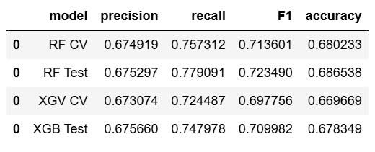
Machine Learning Model Outcomes
Executive summary report for New York City Taxi Limousine Commission
The New York City Taxi and Limousine Commission (TLC) contracted Automatidata to develop a machine learning model to predict whether a taxi riders will be a generous tipper.
Initial objective was rejected due to ethical concern, and it was decided the new objective was to predict type of tipper. Those who tip more than 20% consider as generous tipper. This decision was made to balance the interest of taxi drivers and riders.
Automatidata team built two different models and compared their results. Both models performed acceptably, with random forest model yield better result than extreme gradient boost model. Automatidata recommend beta testing to get further feedbacks.
Automatidata team has assumption that predicted fare amount and time of day may have strong relationship with tip amount
After automatidata team built and identified the models and performed testing, With RF test has F1 score of 0.72349. It is clear that these factors do help predict tip amount.
The resulting algorithm is usable to predict riders who might be generous tippers with reasonably high scores (Precision, Recall, F1, and Accuracy scores)
Automatidata will consult with New York City Taxi and Limousine Commission to share the model results and recommend that the model can be used as an indicator tip amount. However, further additional data will be needed to improve this model.

